Slide 1
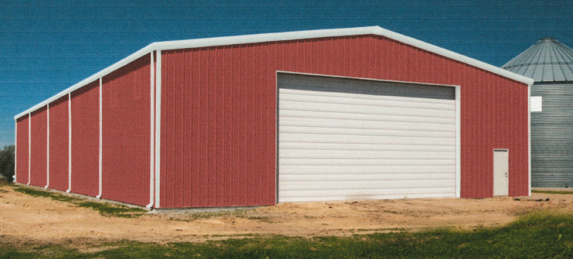
WADMIN19-0018 (Hebert Garage)
Washoe County Board of Adjustment
October 3, 2019

Slide 2
Request
Construction of a detached accessory structure of approximately 2,400 square feet on a parcel of land with a main dwelling of approximately 1,152 square feet.

Slide 3
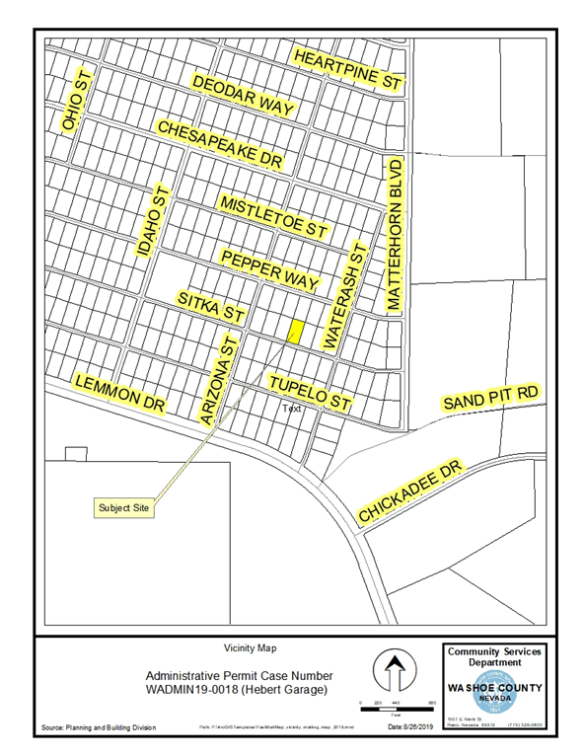
Vicinity Map

Slide 4
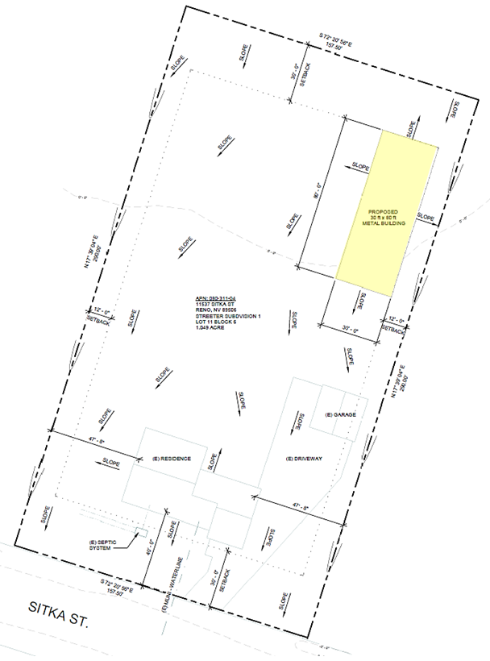
Site Plan

Slide 5
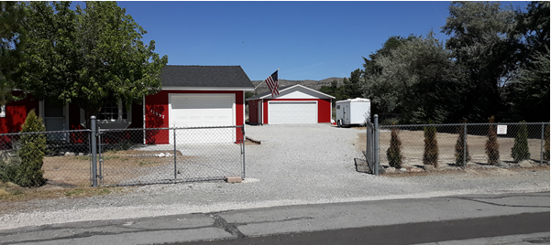
Evaluation
Flat, regularly-shaped lot
Proposed to match existing dwelling and garage
Proposed to meet general Code requirements
Screened by existing dwelling / garage / trees

Slide 6
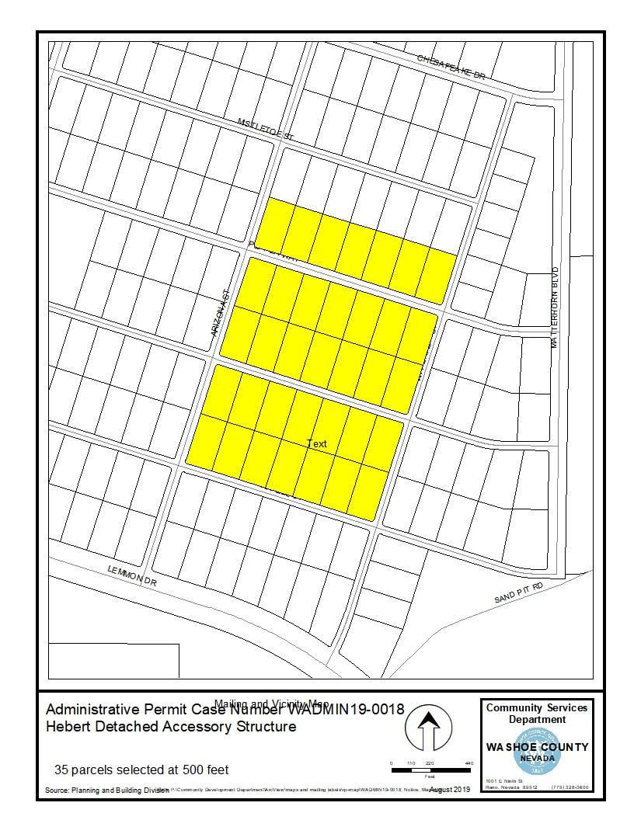
Public Notice & CAB
Notice sent to 35 affected property owners
North Valleys CAB reviewed the application on September 9, 2019 and recommended approval

Slide 7
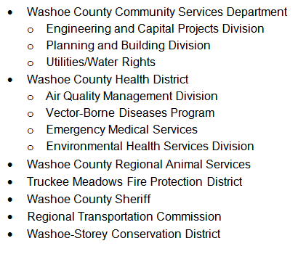
Reviewing Agencies

Slide 8
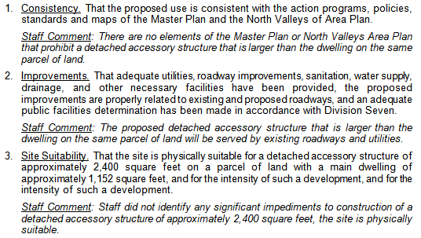
Administrative Permit Findings
Page 8 of staff report

Slide 9
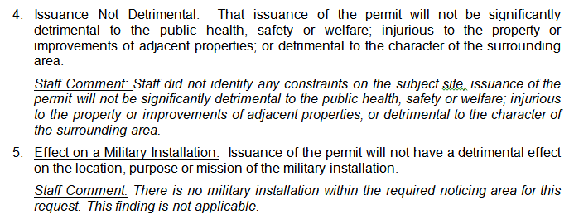
Administrative Permit Findings

Slide 10
Recommendation
Those agencies which reviewed the application recommended conditions in support of approval of the project. Therefore, after a thorough analysis and review, Administrative Permit Case Number WADMIN19-0018 is being recommended for approval with conditions.

Slide 11
Possible Motion
I move that, after giving reasoned consideration to the information contained in the staff report and information received during the public hearing, the Board of Adjustment approve Administrative Permit Case Number WADMIN18-0018 for Scott Hebert, having made all five findings in accordance with Washoe County Development Code Section 110.808.25

